Slide 1
An Ontology Design Pattern for Representing Temporal Indirection
Workshop on Ontology Design and Patterns (ODP) @ ISWC 2025
November 3, 2025
Yulia Svetashova
Data Management Lab

Slide 2
Outline
Motivation & Problem Statement
Indirection in Computer Science
The Temporal Indirection Pattern
Implementation & Validation
State of the Art Comparison
Conclusions & Future Work

Slide 3
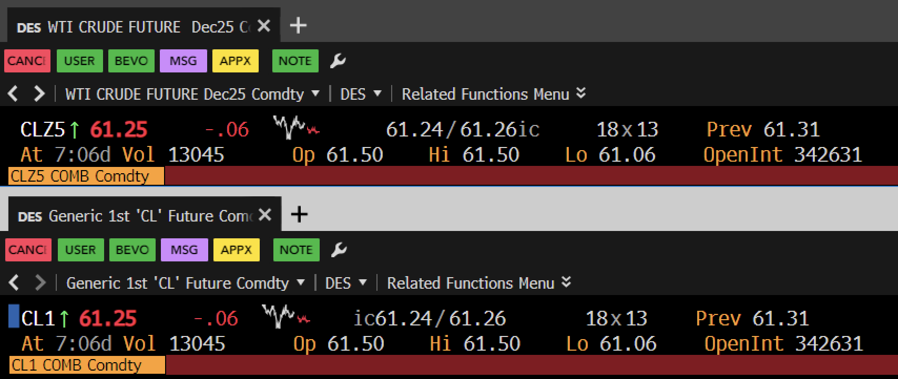
Motivation: Bloomberg Terminal Example
Source: Bloomberg Terminal, CL1 Comdty, DES <GO>, accessed October 29, 2025

Slide 4
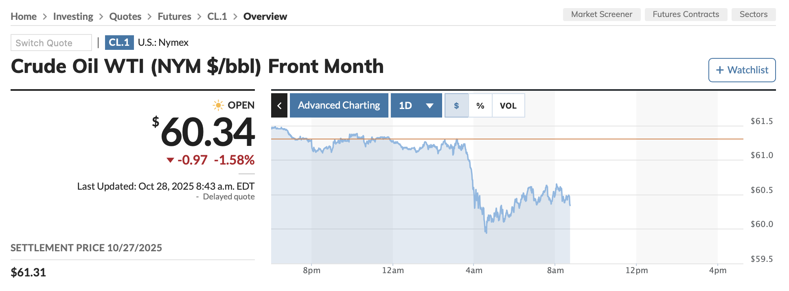
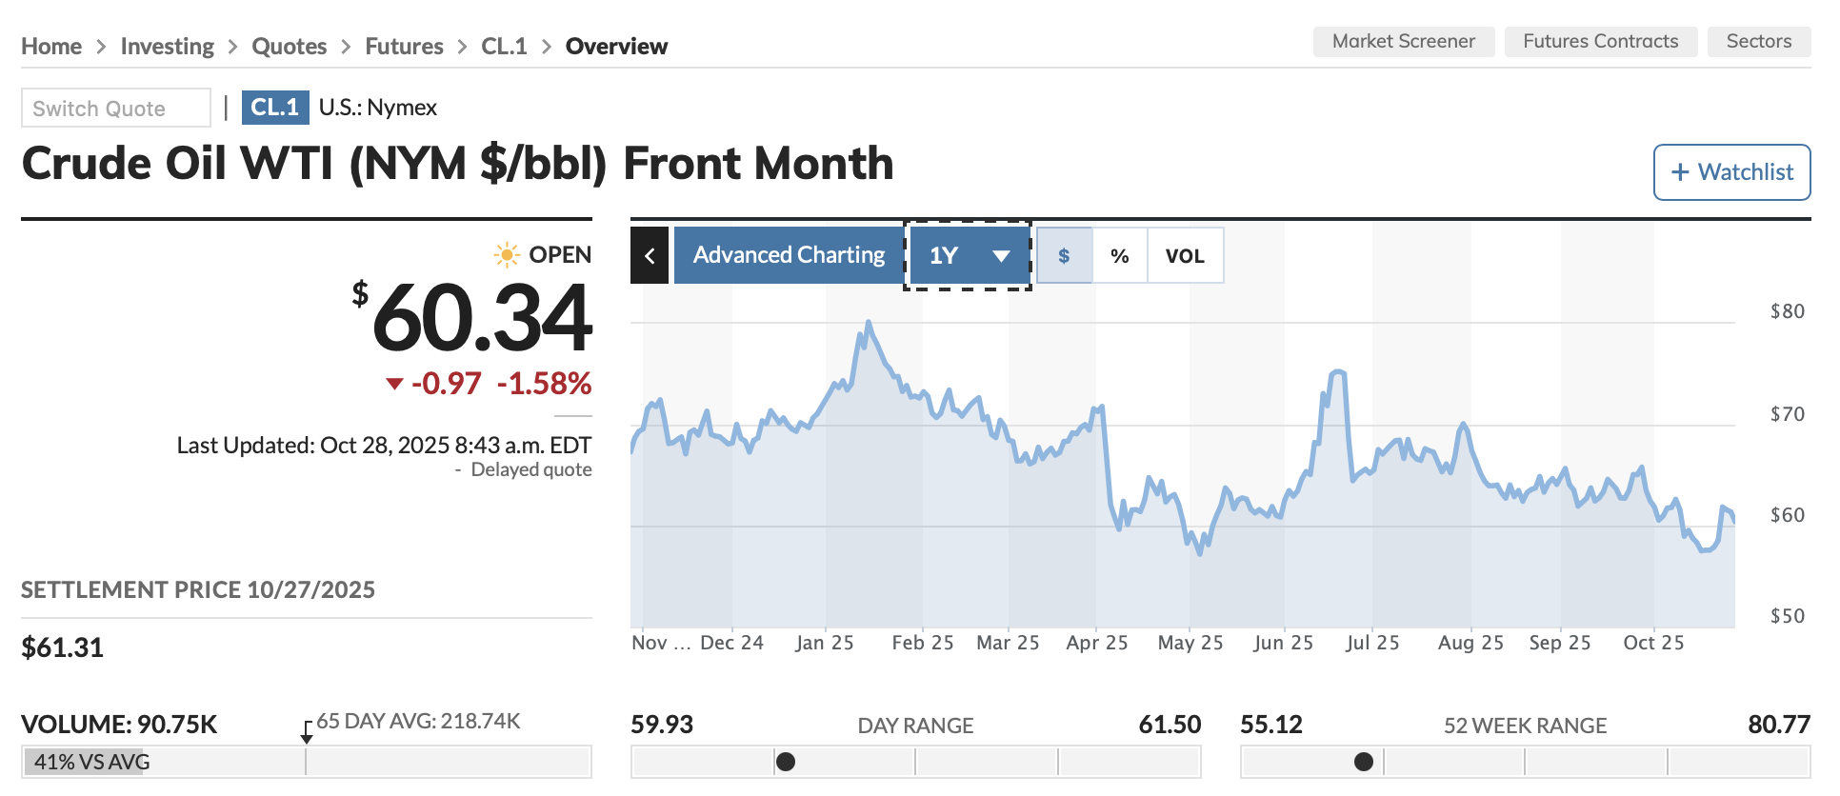
Motivation: Derivatives Contract Tracking
Identifier: CL1
Source: MarketWatch, “Crude Oil Continuous Contract (CL.1),” accessed October 29, 2025
Notes:
CL1 = ‘front‑month WTI crude’. The symbol is persistent, but the contract referenced—changes over time.
Great for continuous charting, risky for historical attribution if we don’t model the mapping explicitly. Aviation has the same pattern.”

Slide 5
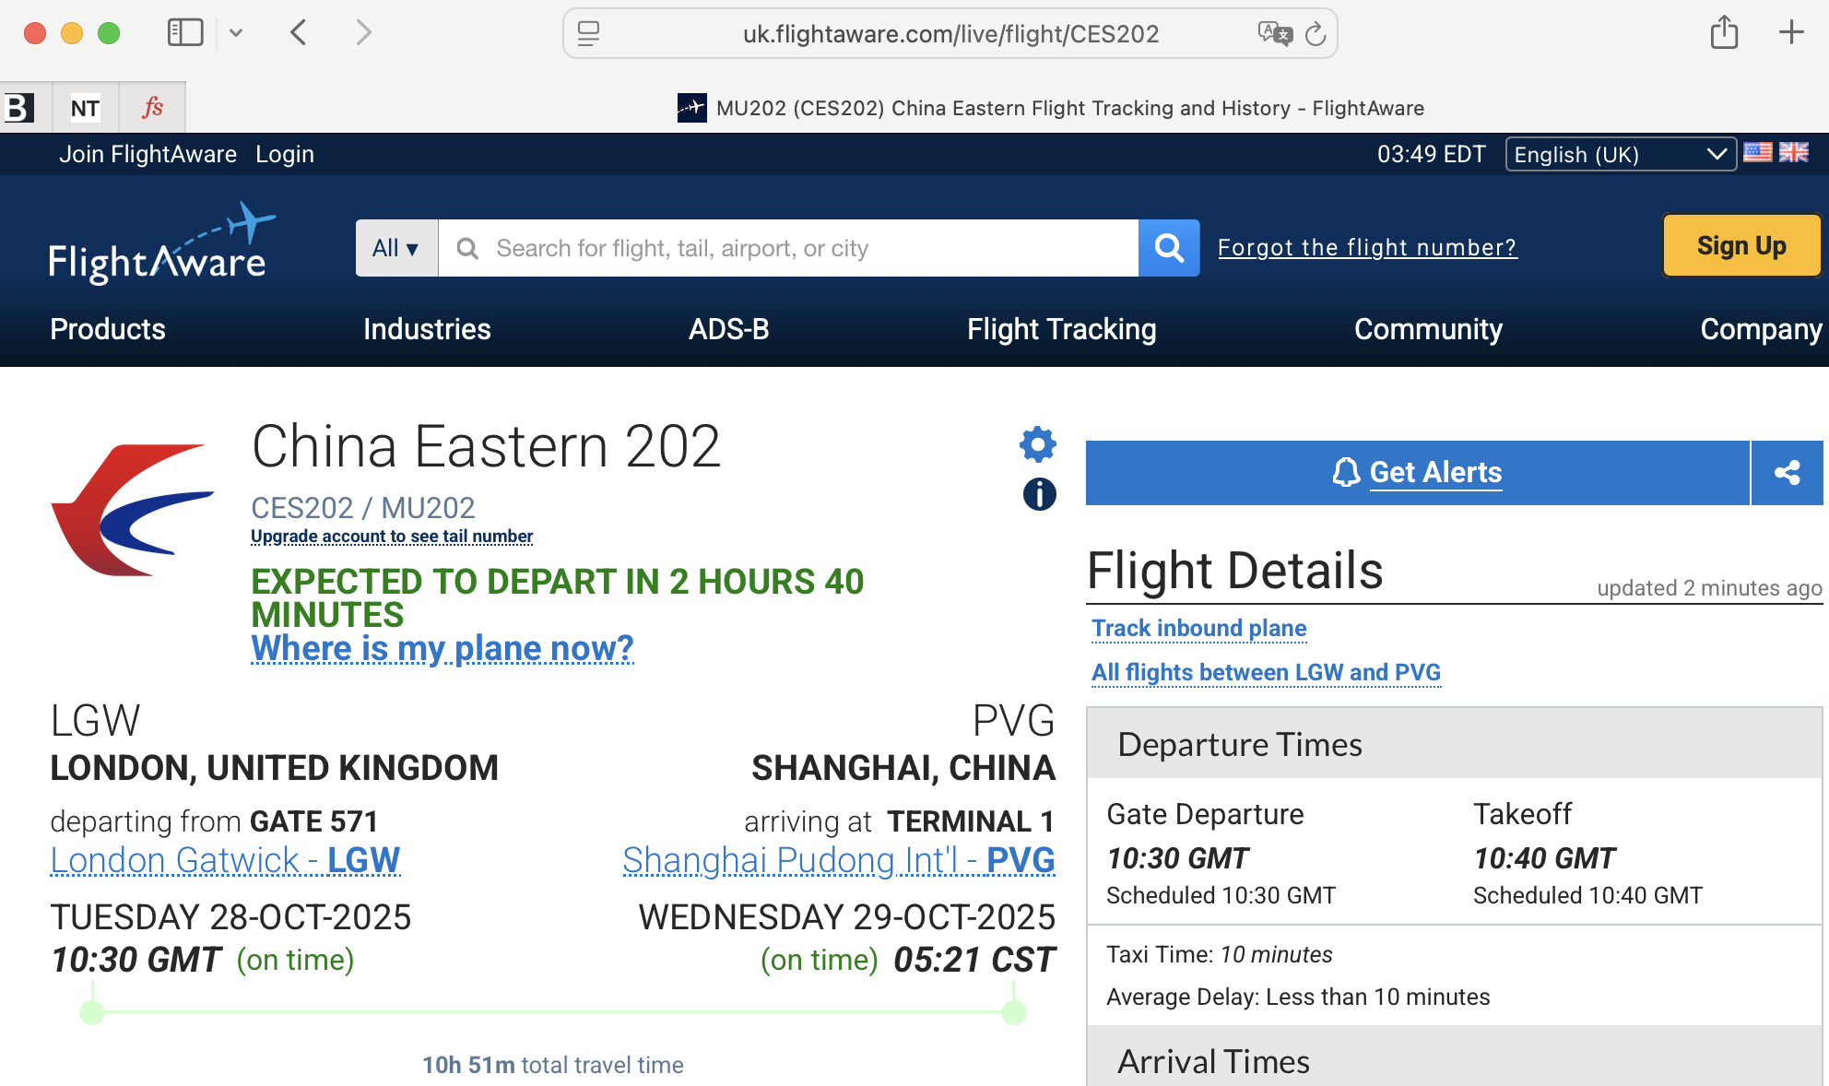
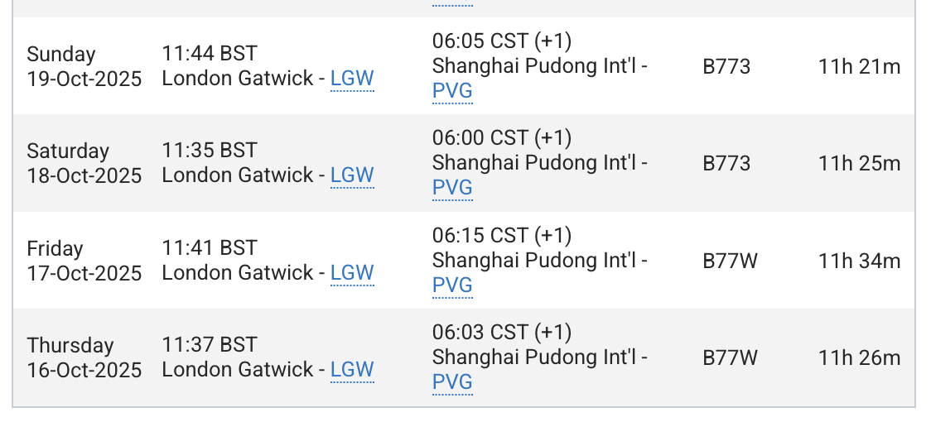
Motivation: Flight Tracking
Identifier: CES202
Source: FlightAware, “CES202 / MU202 (London Gatwick → Shanghai Pudong)”, accessed October 29, 2025
Notes:
CES202 is a daily flight number. It’s a stable label, but each day it denotes a new flight instance with distinct departure times.
Questions like ‘Where is CES202 now?’ vs. ‘What was CES202 on Oct 19?’ demand time‑aware resolution. So, what we want is a persistent identifier that still resolves precisely.

Slide 6
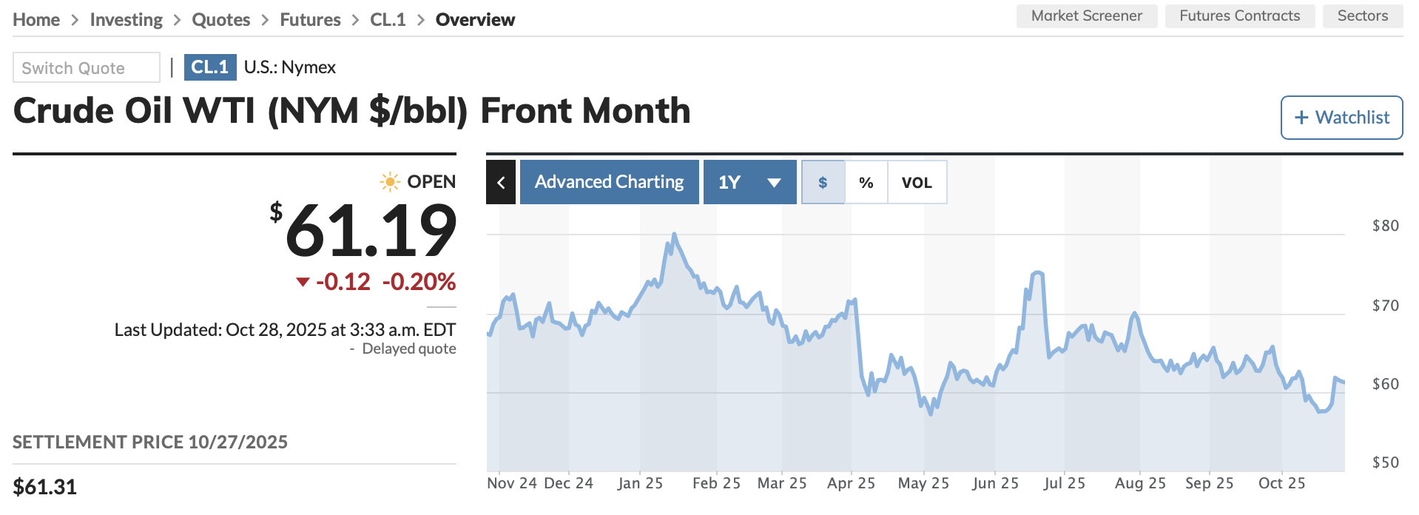
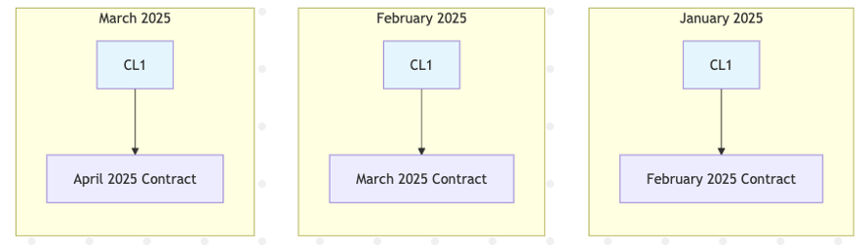
Persistent Identifier
CL1 provides:
Stable reference for continuous charting
Automatic monthly contract transitions
Real-time attributes bound to current contract
Notes:
The benefit: stable reference, automatic transitions, and real‑time attributes bound to whatever the current contract is.
The cost: losing explicit knowledge of which contract at which time unless we model it. Let’s generalize the challenge.

Slide 7
What’s the Problem?
Many information systems require persistent identifiers that remain stable while their referents change systematically over time
Real-World Examples:
"The current president"
"CL1" (front-month oil futures)
"UA001" (daily flight number)
Key Challenge:
How to preserve and represent referential stability while accurately tracking what an identifier denotes at any moment?
Notes:
Many systems need persistent IDs whose referents change systematically.
The key challenge: maintain referential stability and accurate, time‑specific denotation at once. The computer‑science solution for that is indirection.

Slide 8
“All problems in computer science can be solved by another level of indirection.”
– attributed to Butler Lampson*
* Spinellis, Diomidis. "Another level of indirection." Beautiful code: leading programmers explain how they think. Vol. 17. O’Reilly and Associates, 2007. 279–291.
Notes:
We apply that idea to the temporal aspect.

Slide 9
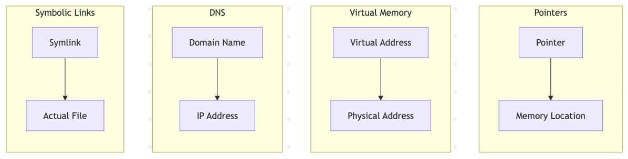
Indirection in Computer Science
Definition
Indirection – Accessing an object through a reference rather than directly

Slide 10
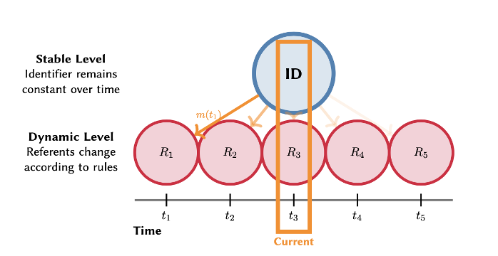
Temporal Indirection Defined
Definition: A situation where a persistent identifier maintains constant identity while the referent changes systematically according to deterministic rules
Mapping Function: m(t) determines which referent R is bound to identifier ID at time t
Notes:
Temporal indirection: a persistent ID remains constant while a deterministic mapping m(t) binds it to a referent at time t.
Diagram: the stable layer (ID) on top, dynamic referents below; m(t) selects R₁, R₂, … at t₁…tₙ.
Example: CL1 at t2 → contract CLG25; later, rolls to CLH25. We package this as an Ontology Design Pattern.

Slide 11
Cross-Domain Applications
Domain | Persistent ID | Changing Referent | Use Case
Finance | CL1 | Monthly contracts | Continuous trading
Healthcare | Primary Oncologist Ward 7 | Individual physicians | Treatment continuity
Aviation | UA001 | Daily aircraft/crews | Flight operations
Digital Services | Payment API Latest | Implementation versions | Client stability
Environmental | River Station 1 | Physical sensors | Regulatory compliance
Regulatory | Current GDPR | Specific rulings | Compliance tracking

Slide 12
Ontology Design Patterns
Ontology Design Patterns (ODPs) are reusable solutions to recurring problems in ontology engineering, comparable to design patterns in software development.
Originating from the concept of pattern languages in architecture and later widely adopted in software engineering, ODPs were introduced to the Semantic Web community in the mid-2000s to improve ontology quality and efficiency.
Various projects in industry and academia demonstrated that ODPs can facilitate collaborative ontology development.
Notes:
ODPs directly enable knowledge generation in tools and workflows.

Slide 13
Pattern Requirements
R1. Identifier Persistence: Stable identity across time
R2. Deterministic Resolution: Unambiguous mapping at any point in time
R3. Rule-Based Transitions: Explicit domain rules
R4. Historical Traceability: Complete audit trail

Slide 14
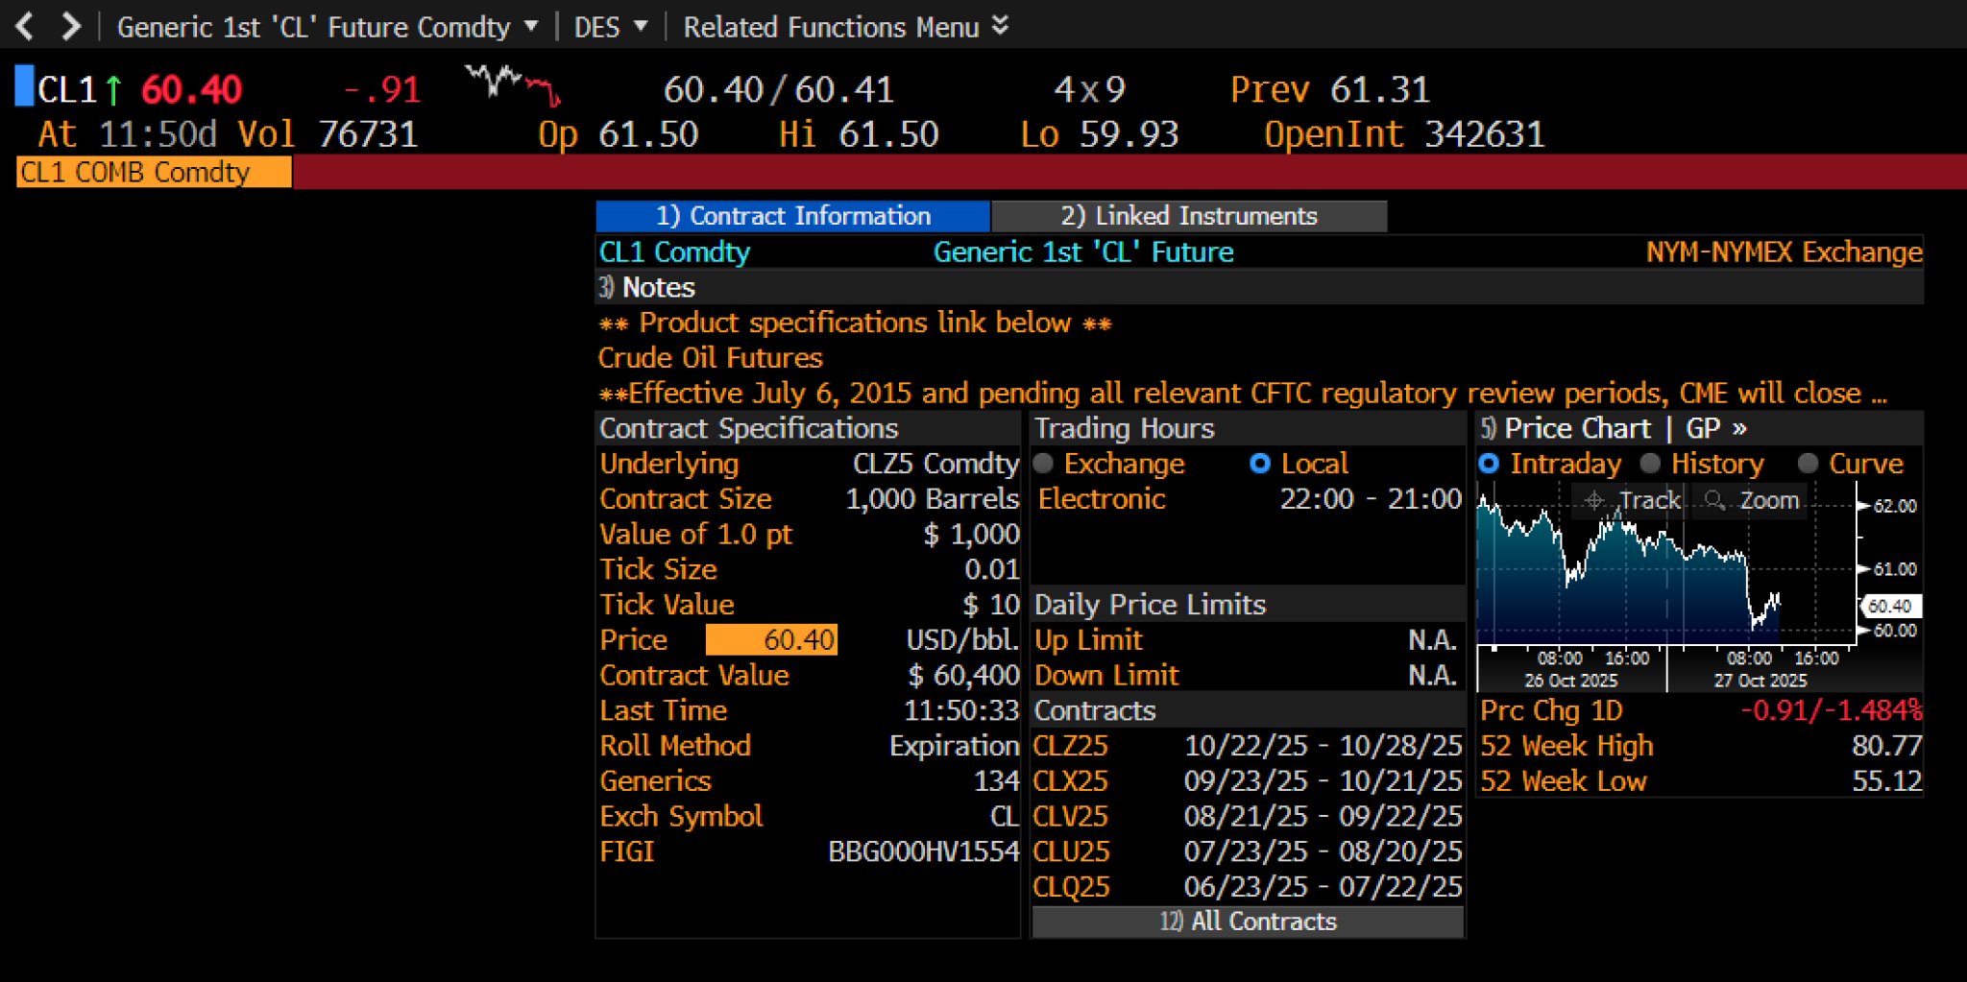
Working Example: CL1 → CLZ5 (**October 2025)
Source: Bloomberg Terminal, CL1 Comdty, DES <GO>, accessed October 29, 2025

Slide 15
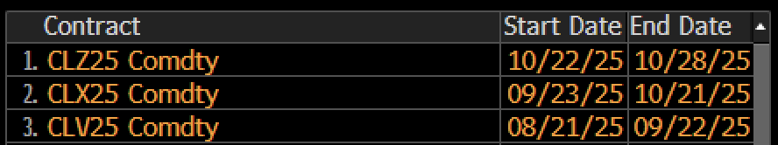
Working Example: CL1 → CLZ25
CL1
CLV25
CLX25
CLZ25

Slide 16
Working Example
R1. Identifier Persistence
R2. Deterministic Resolution
R3. Rule-Based Transitions
R4. Historical Traceability
ID: CL1
Futures:
CLV25 (Oct25)
Futures:
CLX25 (Nov25)
Futures:
CLZ25
(Dec 25)
CLF26 (Jan 26)
Event X
Event Y
Event Z
T
T
Now
T

Slide 17
Working Example
ID: CL1
NYMEX Convention
has resolution context
has temporal binding
has temporal binding
CL_Oct25_
Validity_
Period
CL_Nov25_
Validity_
Period
follows
CL1 Roll Schedule
CL1_Sep25_Mapping
CL1_Oct25_Mapping
CL1_Nov25_Mapping
binds
binds
has transition-out
has transition-in
defines
Futures:
CLX25 (Nov25)
Futures:
CLZ25
(Dec 25)
CLF26 (Jan 26)
CL1_Roll_Rule E.g. “roll on 9th business day before the 25th prior to delivery”
changes
is triggered by
Event: Roll_CL1_Nov25_to_Dec
Roll_CL1_Dec25_to_Jan26
T
T
Now
T

Slide 18
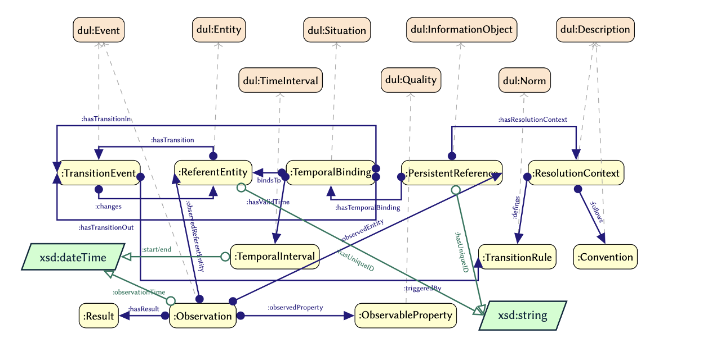
Pattern Architecture
Notes:
Key pieces: PersistentReference, ReferentEntity, TemporalBinding, TransitionEvent, TransitionRule, ResolutionContext, and Convention.
Flow: a PersistentReference acquires TemporalBindings; each binding has a valid time interval; TransitionEvents switch from/to referents, triggered by rules; observations attach to the referent and time.
This structure cleanly separates the stable ID from time‑varying denotation.

Slide 19
Core Components
Core Classes
Persistent Reference: Stable identifier (e.g., "CL1")
Referent Entity: Actual entity referenced (e.g., "CLG25")
Temporal Binding: Reified identifier-referent relationship
Transition Event: Moment of referent change
Transition Rule: Domain logic for transitions
Resolution Context: Interpretive framework
Convention: Domain-specific standards
Key Design Decision
Reification of temporal binding enables:
Precise temporal boundaries
Transition event tracking
Temporal integrity validation
Notes:
Persistent Reference (e.g., CL1), Referent Entity (e.g., CLG25), Temporal Binding (reified relation), Transition Event, Transition Rule, Resolution Context, Convention.
Design decision: reify the binding—this gives precise boundaries, event tracking, and integrity checks. Next, the formal constraints and what they guarantee.

Slide 20
Structural Constraints
PersistentReference ⊑ (∃ hasTemporalBinding.TemporalBinding)
⊓ (=1 hasResolutionContext.ResolutionContext)
TemporalBinding ⊑ (=1 bindsTo.ReferentEntity)
⊓ (=1 hasValidTime.TemporalInterval)
TransitionEvent ⊑ (=1 changesFrom.ReferentEntity)
⊓ (=1 changesTo.ReferentEntity)
⊓ (=1 triggeredBy.TransitionRule)
Guarantees:
Completeness: Every identifier has bindings
Determinism: One referent per interval
Traceability: Complete transition history
Notes:
Every Persistent Reference has Temporal Bindings with exactly one referent and exactly one valid interval.
Every TransitionEvent has exactly one from, one to, and is triggered by a TransitionRule.
Guarantees: completeness (no unbound IDs), determinism (no two referents in the same interval), and traceability (full transition history). What questions can we now answer?

Slide 21
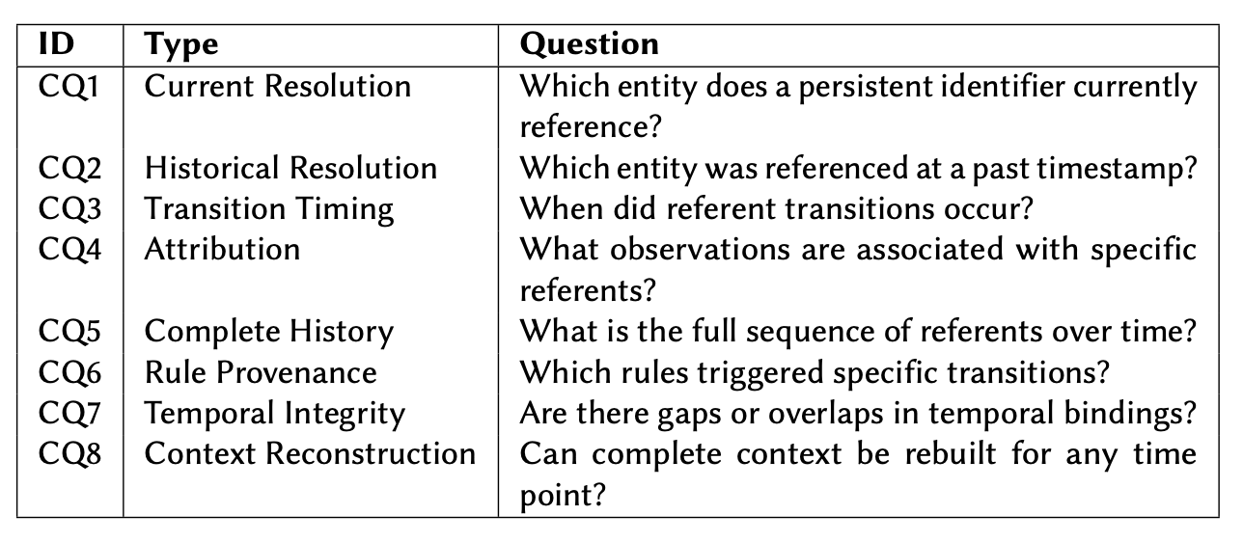
Competency Questions (Generic)
Notes:
Acceptance tests include: current referent, historical resolution, transition timing, attribution, complete history, rule provenance, temporal integrity, and context reconstruction.
If the model answers these, the pattern works. Let’s specialize to derivatives.

Slide 22
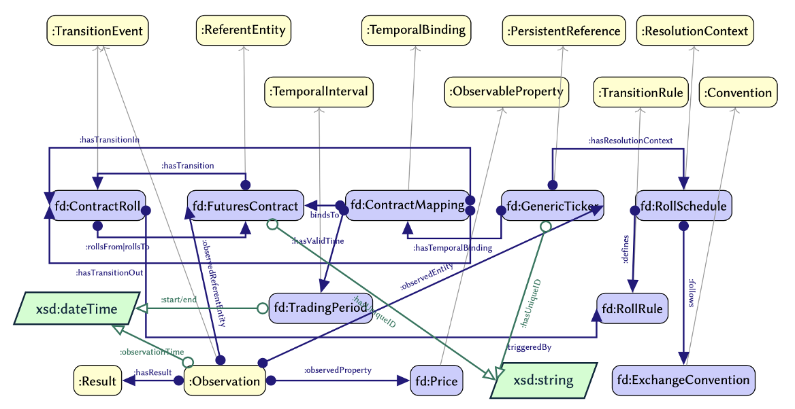
Pattern Specialisation: Derivatives
Notes:
Specialized classes: FuturesContract, ContractRoll, ContractMapping, RollRule, RollSchedule, GenericTicker(e.g., CL1), TradingPeriod, with Price observations.
This captures how a generic ticker rolls across monthly contracts per exchange rules. And the domain‑specific questions follow.

Slide 23
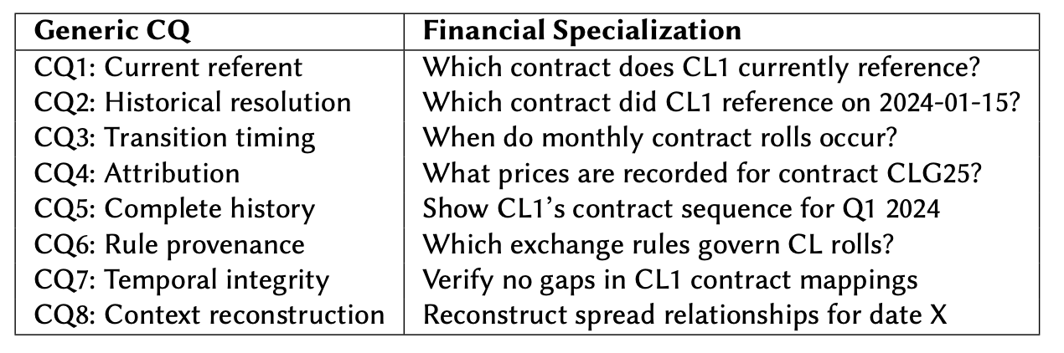
Competency Questions Specialisation: Derivatives
Notes:
Examples: ‘Which contract does CL1 reference now?’ ‘Which contract on 2024‑01‑15?’ ‘When do rolls occur?’ ‘What prices belong to CLG25?’ ‘Show Q1 2024 contract sequence.’ ‘Which exchange rules govern rolls?’ ‘Verify no gaps in mappings.’ ‘Reconstruct spreads for a given date.’

Slide 24
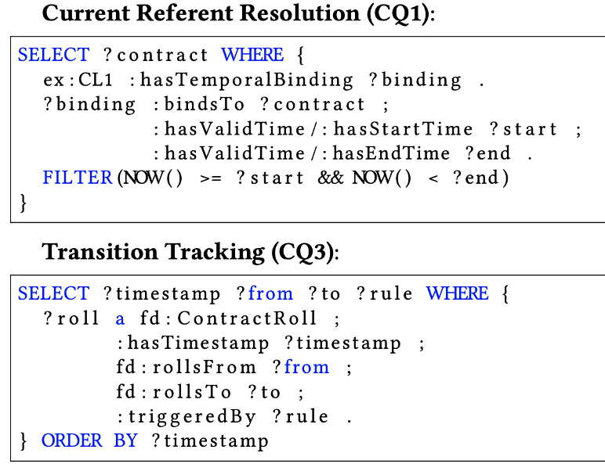
Key SPARQL Queries

Slide 25
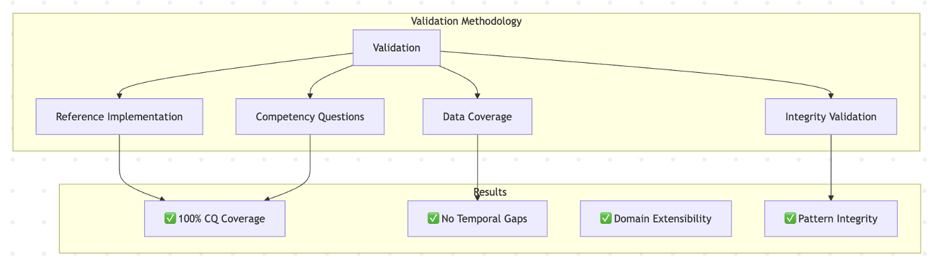
Cross-Domain Validation
Domains tested:
Financial Derivatives (3-month data)
Air Transportation (daily operations)

Slide 26
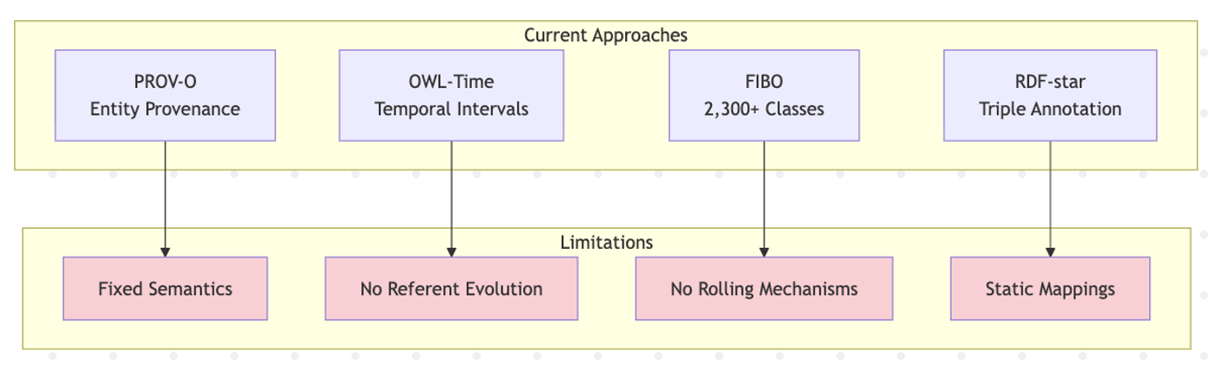
Existing Temporal Approaches
Gap: No existing pattern separates identifier persistence from referent dynamics

Slide 27
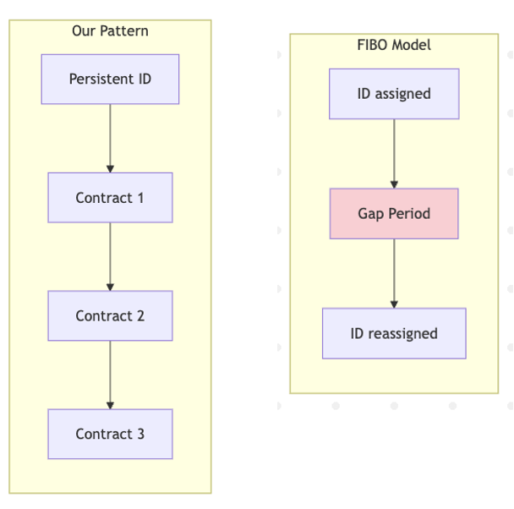
Comparison - FIBO's Reassignable Identifier
Definition: "Identifier reused after periods of non-use"
Example: Vanity license plates transferred between vehicles
Properties:
hasAssignmentTerminationDate
hasInitialAssignmentDate
Source: Enterprise Data Management Council, Financial industry business ontology (FIBO). Accessed: October 29, 2025.
❌ Models discrete reuse with gaps ❌ No transition rules ❌ No historical sequences ❌ No dual attribution
✅ Our pattern:
Continuous, rule-governed evolution

Slide 28
Related Patterns Comparison
Pattern | Purpose | Temporal Indirection?
Time-indexed Value (Peroni et al. 2012) | Property changes over time | ❌ Fixed identifier semantics
Situation Patterns (Borgo et al. 2022) | Contextualize occurrences | ❌ Events, not references
4D/Fluents (Welty et al. 2006) | Temporally extended entities | ❌ Property focus
Recurrent Situations (Carriero et al. 2021) | Periodic events | ❌ Discrete, not continuous
Calendar Patterns (Ohlbach 2004) | Complex recurrence rules | ❌ No identifier layer
Our Pattern | Evolving referents | ✅ Explicit indirection

Slide 29
Future Work
Short-term:
Full DL Axiomatization with temporal semantics
Performance Benchmarks on large datasets
OTTR Templates for easier adoption
Medium-term:
Triplestore Optimization studies
Additional Domain validations
Tool Support development
Long-term:
Standardization efforts
Integration with existing ontologies
Reasoning complexity analysis

Slide 30
Summary
The Problem: Systems need stable identifiers for evolving referents
Our Solution:
Temporal Indirection Pattern – First pattern to explicitly separate:
Persistent identifiers (stable layer)
Referent entities (dynamic layer)
Temporal bindings (connection rules)
Validation:
Tested in finance & aviation
100% competency question coverage
Impact: Fills critical gap in temporal knowledge representation

Slide 31
Thank you!

